Slide 1
Autonomous Flag Finder
Burnout Squad
Jeremiah McCutcheon: Project Manager
David Koblah: Hardware Design
Michael Bates: Software Design

Slide 2
System Description
This system is an autonomous robot designed to locate, identify and retrieve flags inside a room or maze.
It will utilize a camera and proximity sensors to navigate its environment.
The camera will wirelessly communicate with a computer in order to identify flags and retrieve them.
A microcontroller will control the movement of the tank, proximity sensors and servo motors to rotate the camera or retrieve the flags.
David Koblah

Slide 3
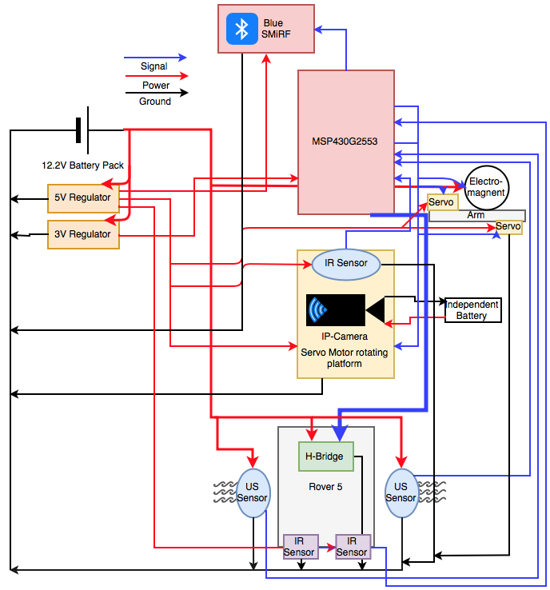
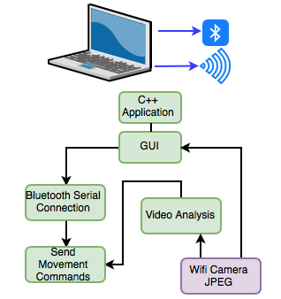
System Diagram
David Koblah

Slide 4
Division of labor
Jeremiah: Bluetooth Serial Communication Interface with Mac, Video Camera Interface with Mac, Image Processing
David: BlueSMiRF receiving communication, Servo arm and Electromagnet interface, Flag Collection
Michael: IR sensor implementation, Ultrasonic Sensor implementation, Autonomous Navigation, PCB, Budget
Michael Bates

Slide 5
Safety Concerns
Our primary safety concern this week has been managing the 9.6V battery to avoid any fires and over volting microcontroller circuits. We may also add a warning signal to our design to prevent fellow lab users from running into the rover.
Making sure not to connect to TTU with lab router.
Wearing appropriate Personal Protective Equipment
Pants
Closed Toed Shoes
Safety Glasses
David Koblah

Slide 6
Last Week’s Deliverables
Jeremiah
Continue Working on C++ GUI✅
Continue IP Camera Integration✅
Continue Working on ‘Blob Identification’ Code❌
David
Continue Constructing Servo Arm✅
Begin Servo Arm Code✅
Michael
Finish PCB Design✅
Finish Maze Navigation Code✅
Michael Bates

Slide 7
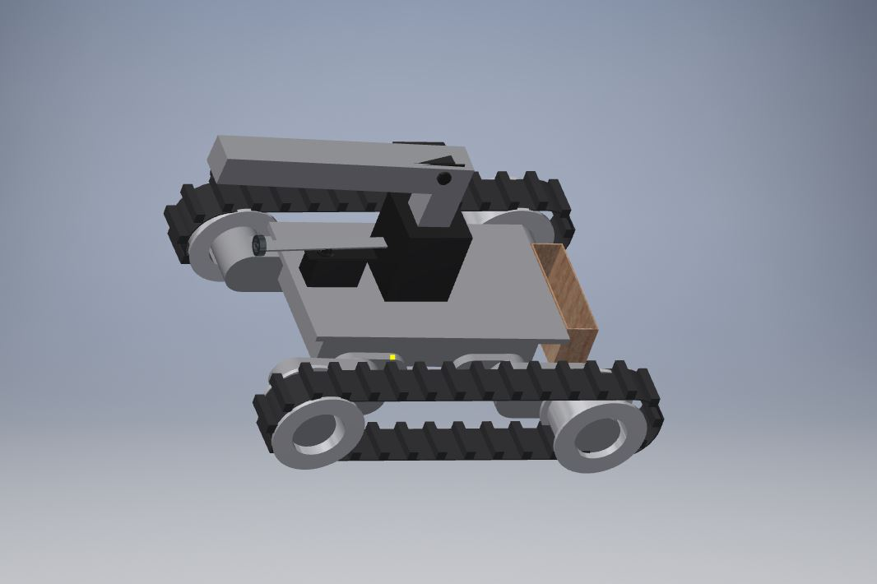
Recall Rover Basic Design...
David Koblah

Slide 8
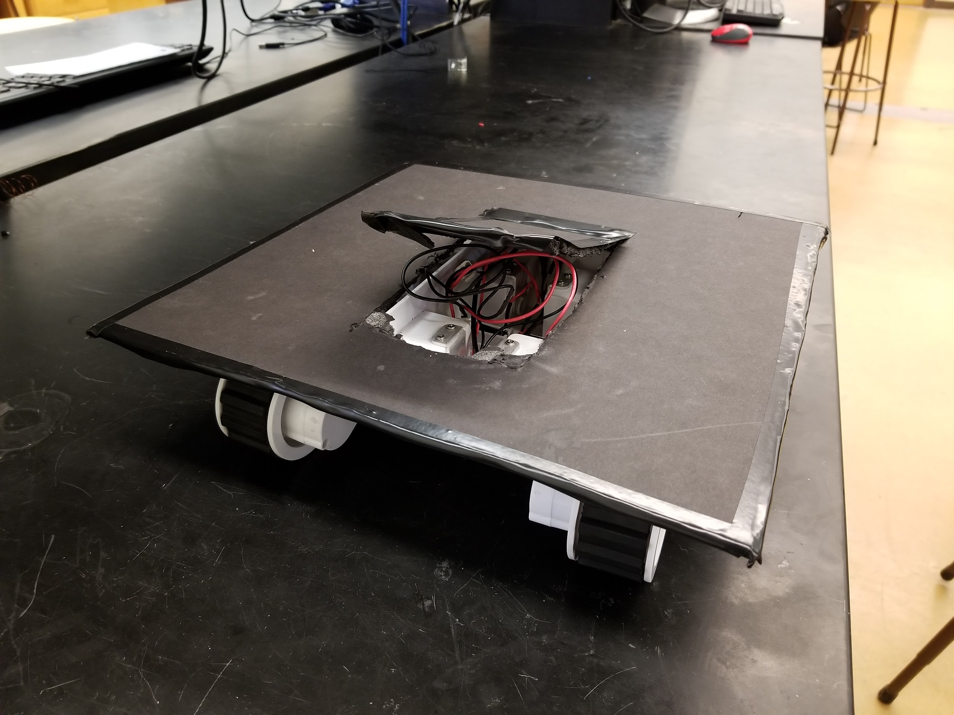
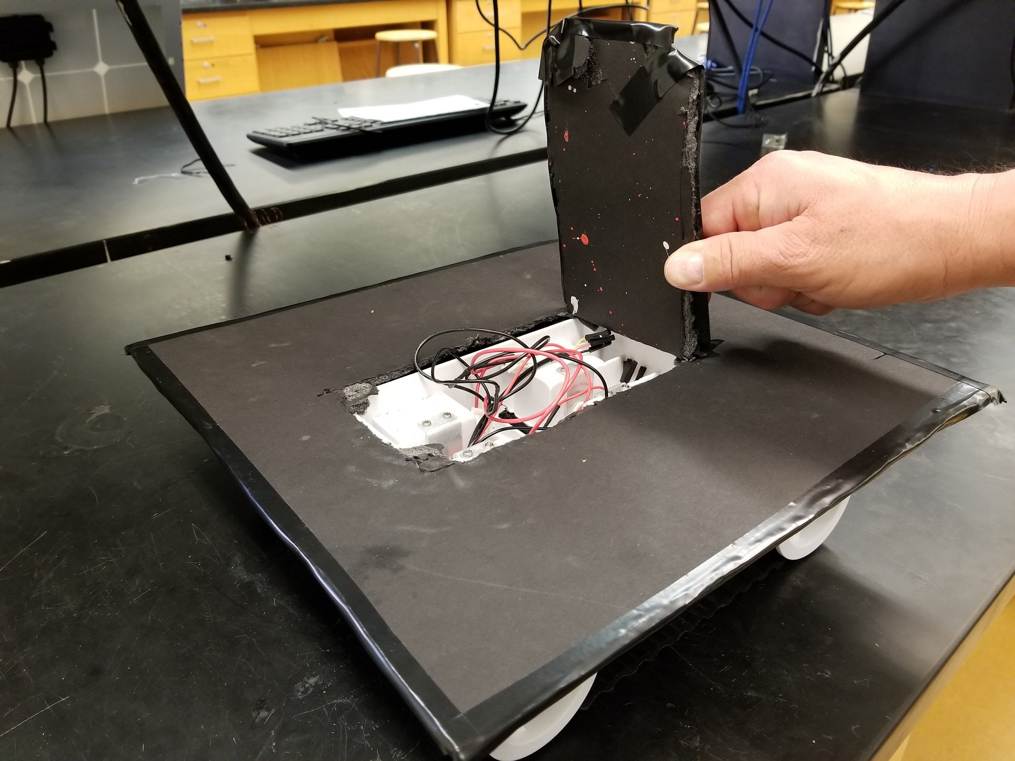
Robot Base With Hatch
Hatch for access to motors and Rover 5 wiring
Broader base to accommodate components
David Koblah

Slide 9
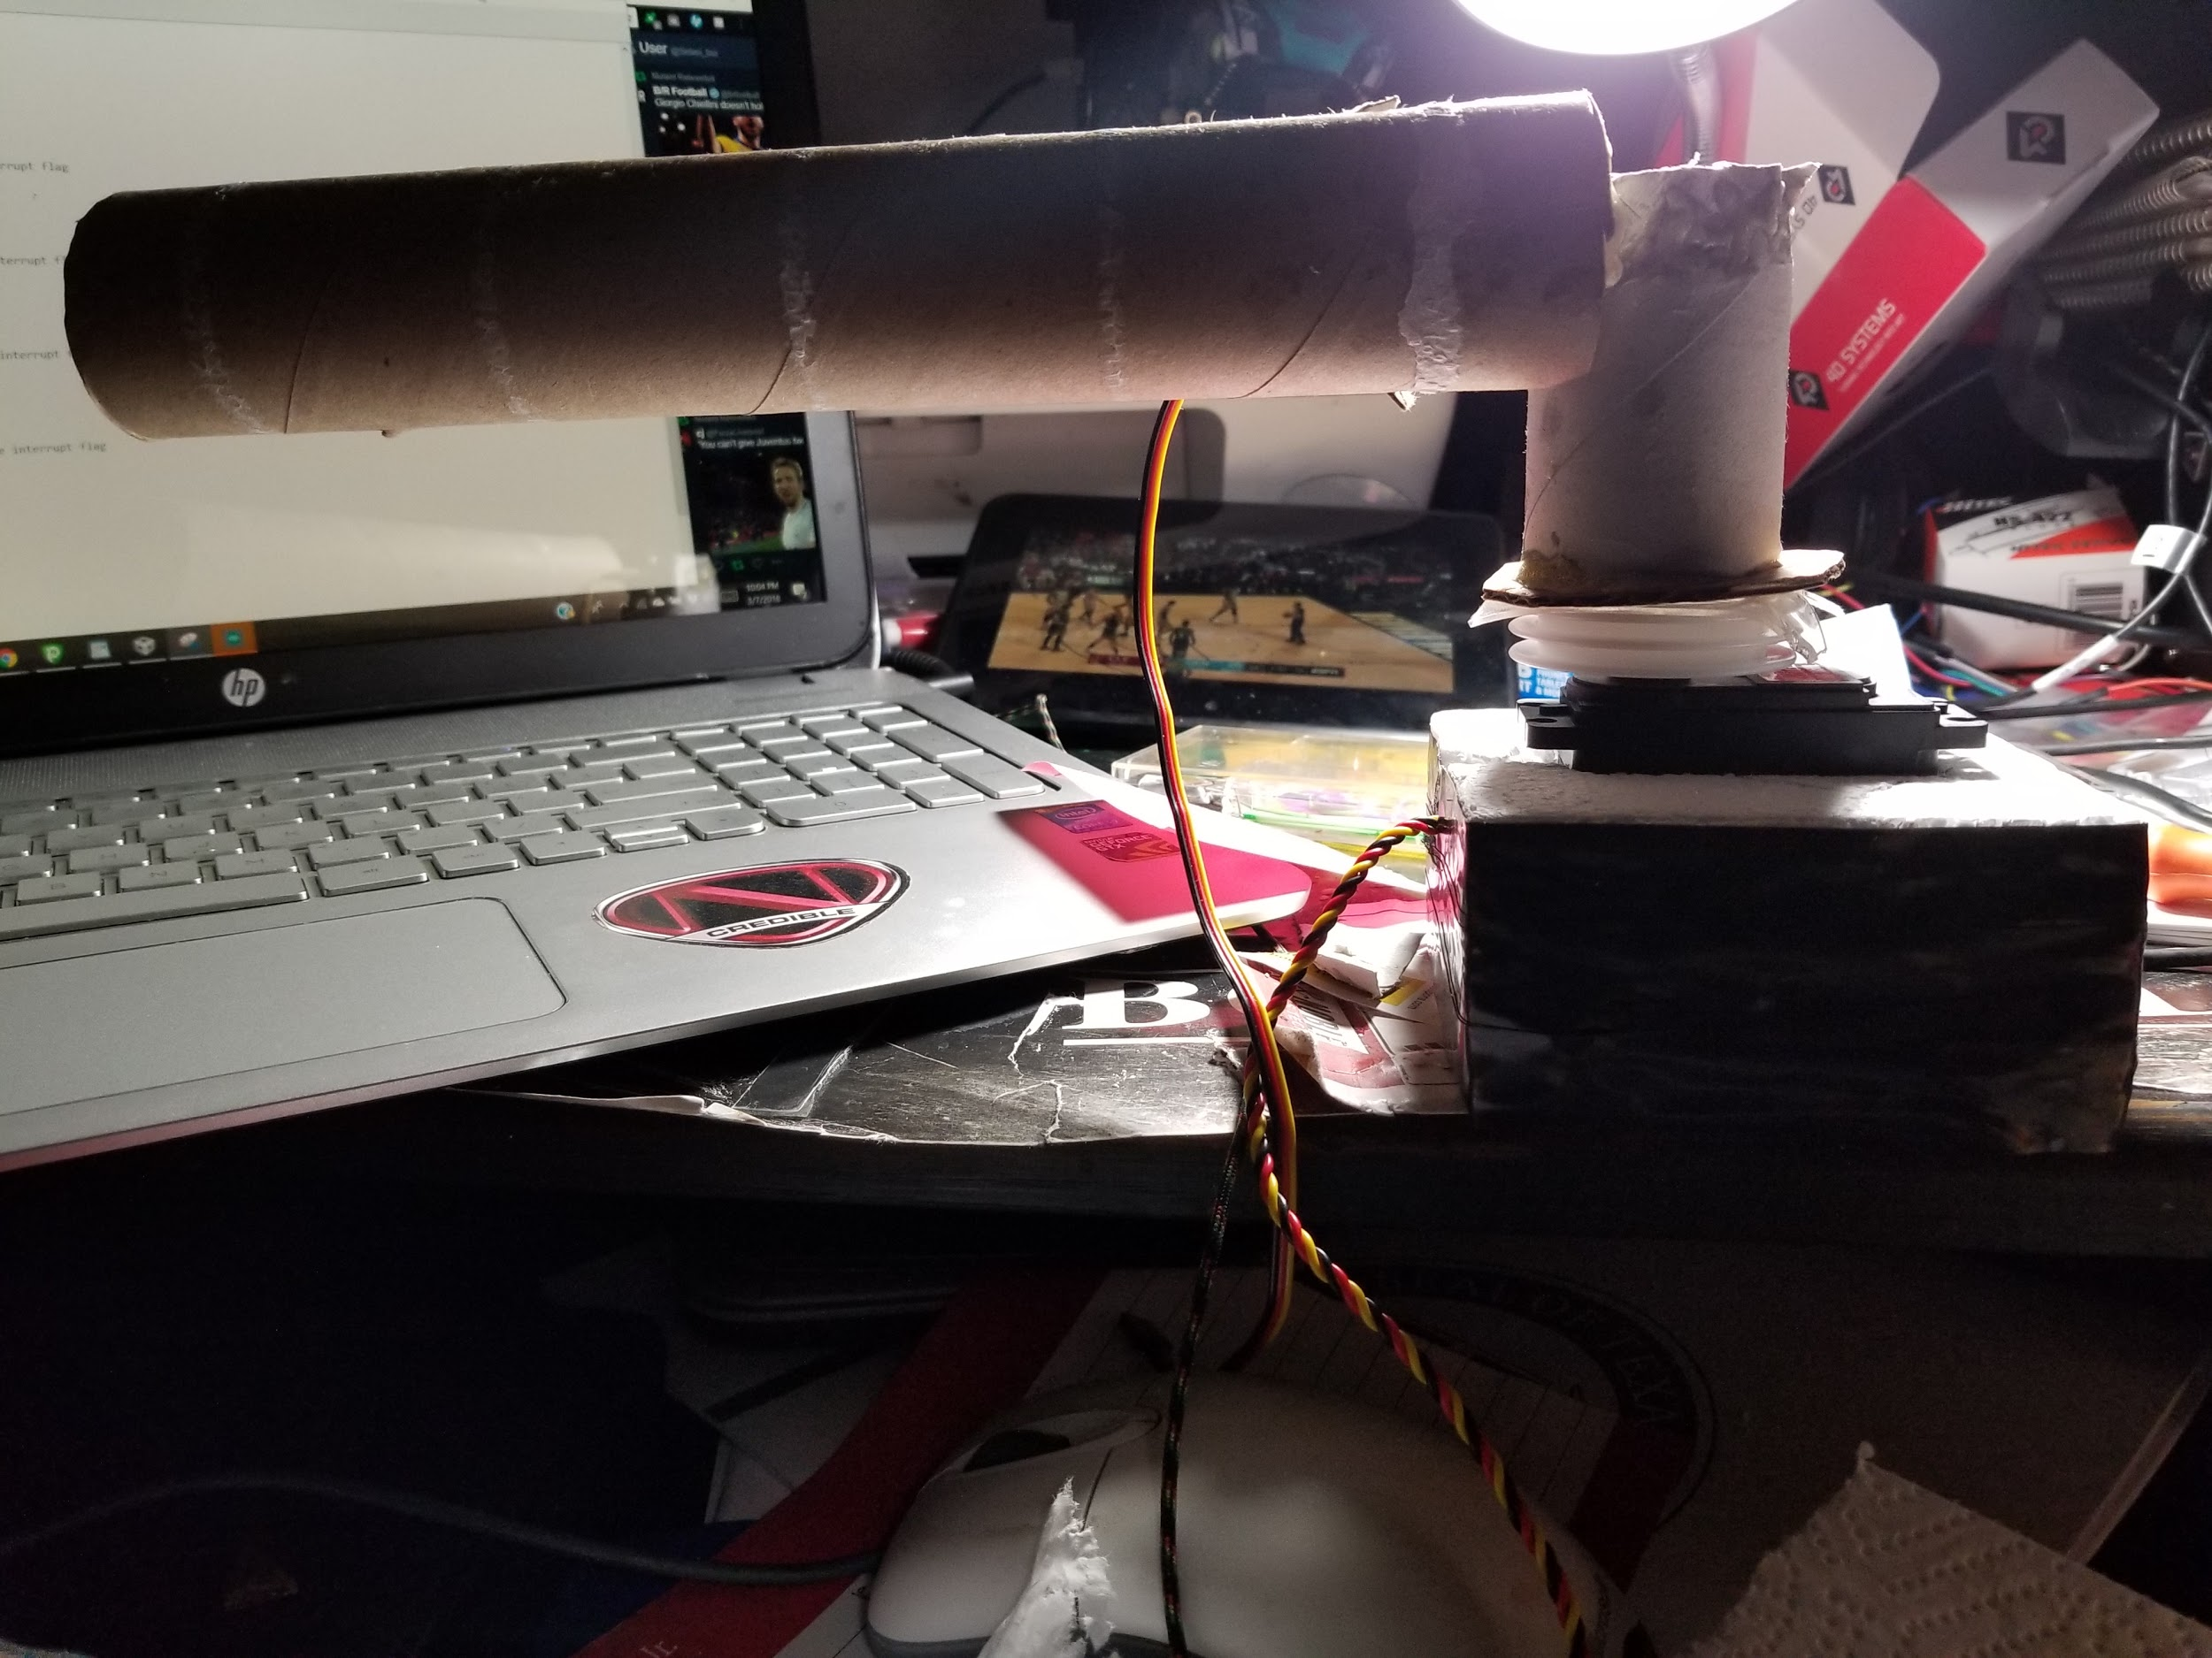
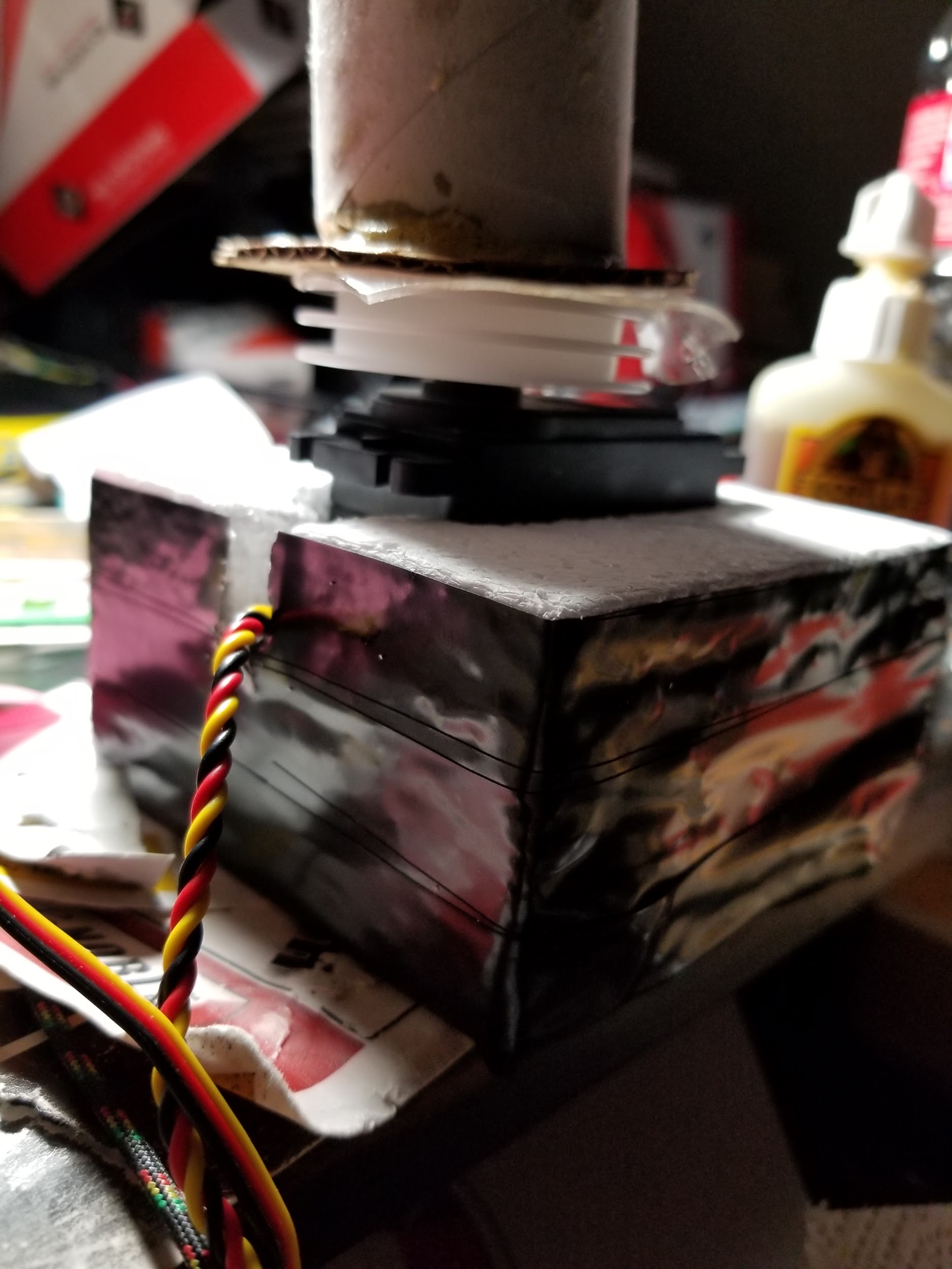
Skeleton Frame of Robot Arm using Recycled Material
Foam Base with Embedded Servo
David Koblah

Slide 10
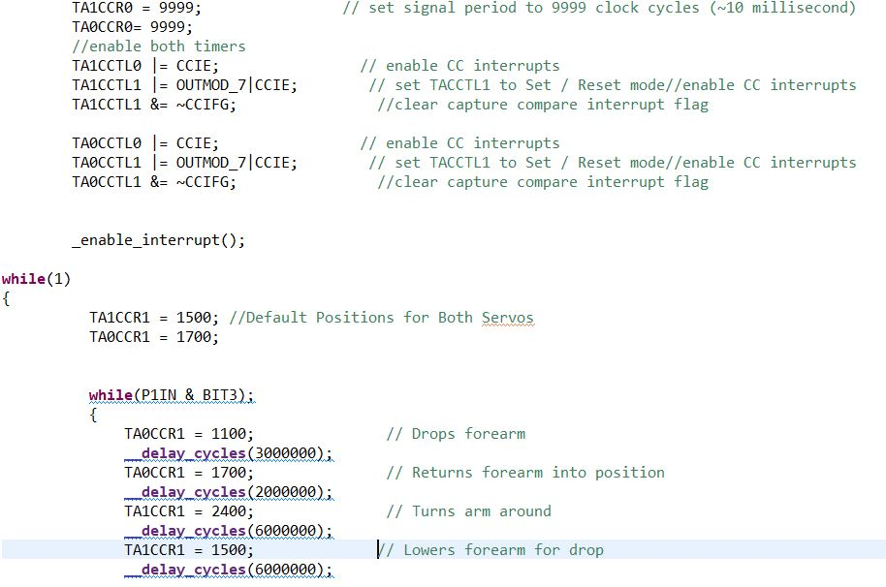
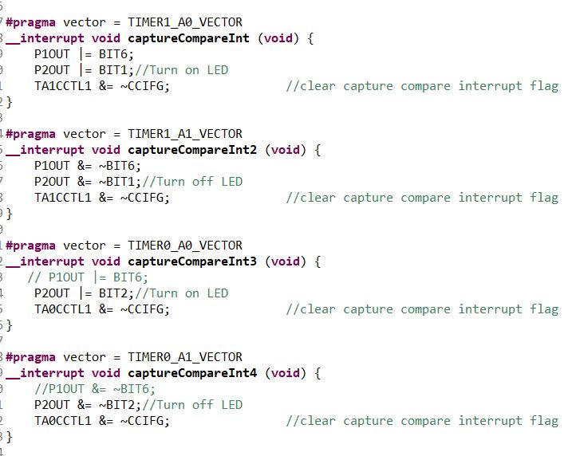
Robot Arm Sample Motion Code
Flag retrieval routine
David Koblah

Slide 11
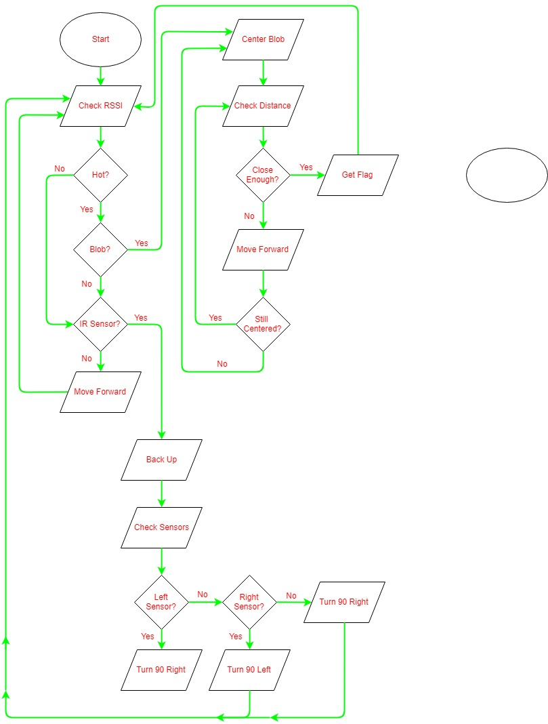
Navigation Flowchart
Michael Bates

Slide 12
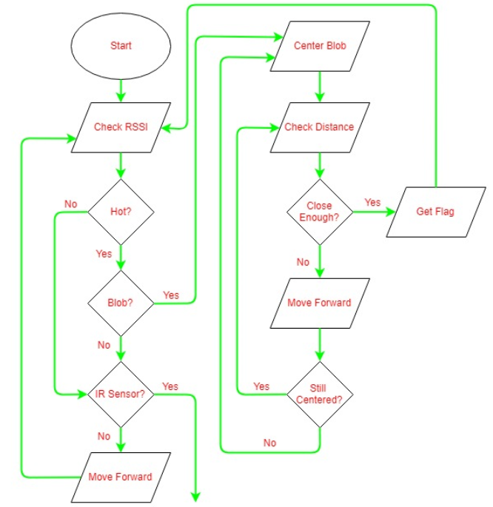
Blob Detection Interrupt
Michael Bates

Slide 13
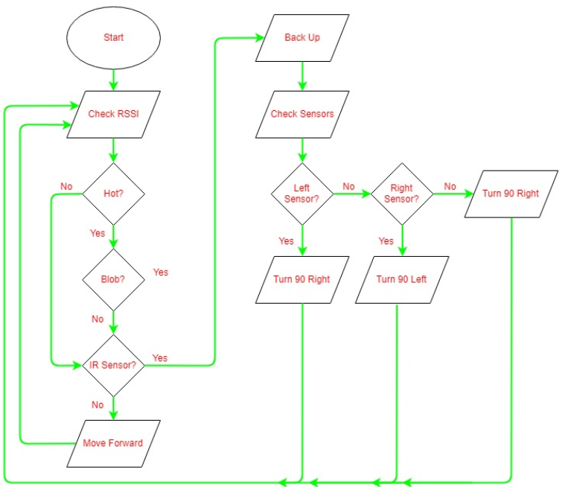
Ultrasonic Sensor Interrupt
Michael Bates

Slide 14
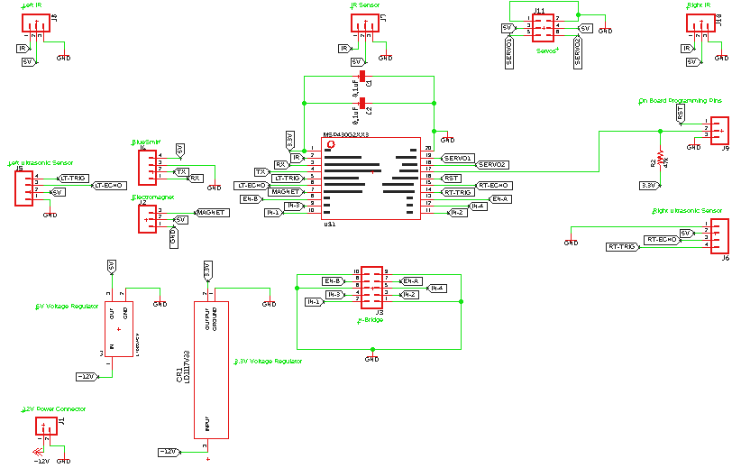
Eagle Schematic
Michael Bates

Slide 15
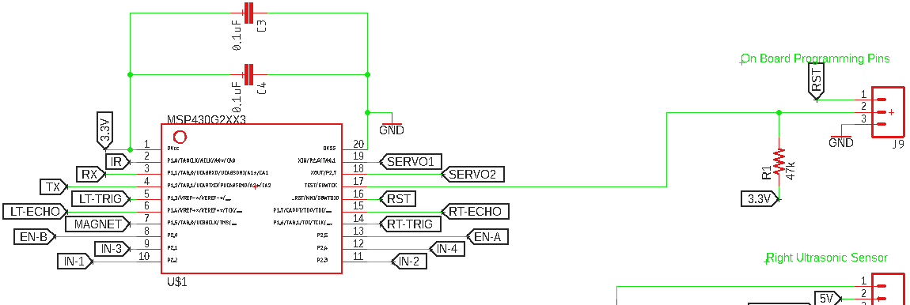
On Board Programming
Michael Bates

Slide 16
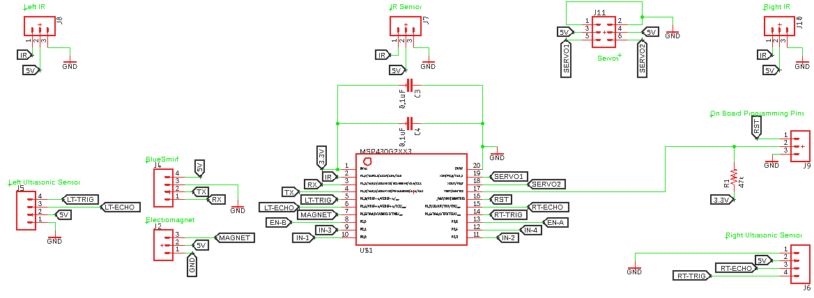
Navigation and Flag Retriever Components
Michael Bates

Slide 17
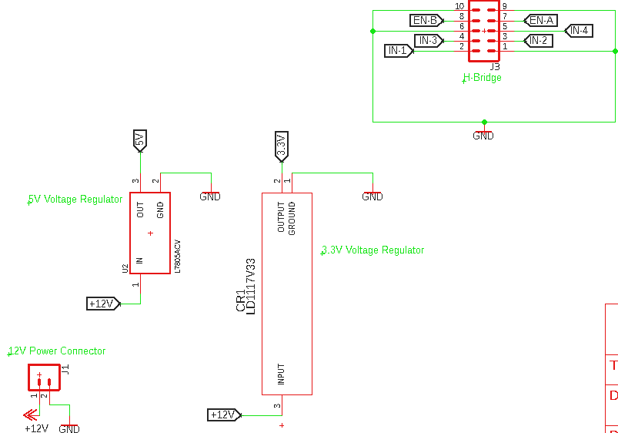
Power and
Drive
Michael Bates

Slide 18
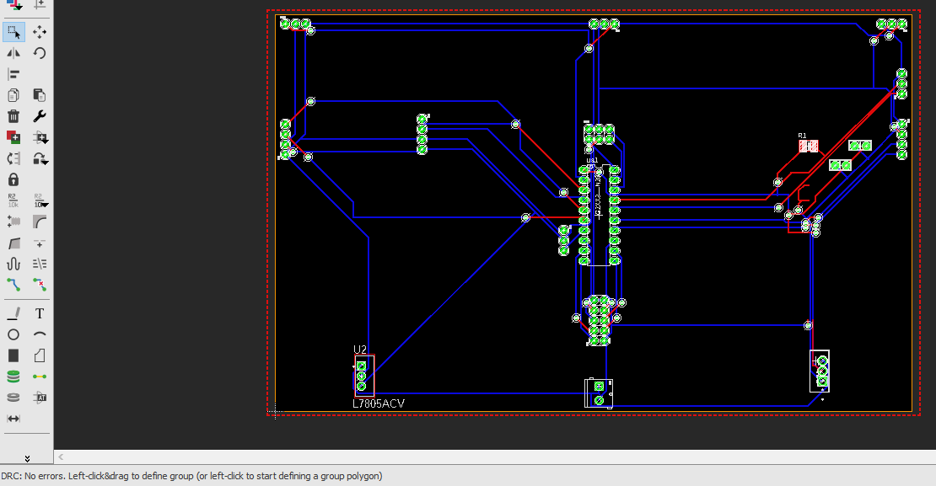
PCB
Michael Bates

Slide 19
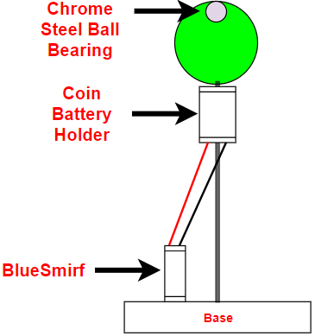
Turning Off Bluetooth Beacons
Michael Bates

Slide 20
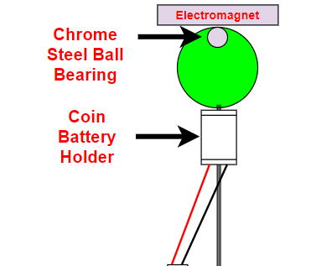
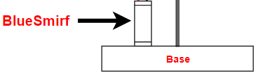
Turning Off Bluetooth Beacons Continued
Michael Bates

Slide 21
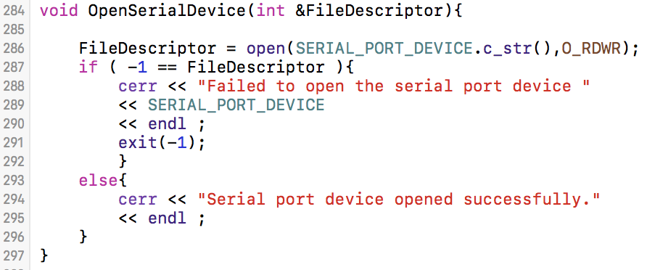
Serial Communication
Attempt to open serial port
Jeremiah McCutcheon

Slide 22
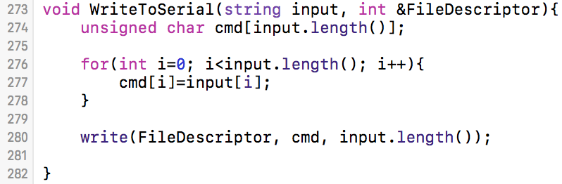
Serial Communication
Create communication buffer
Convert string to char
Send to serial port
Jeremiah McCutcheon

Slide 23
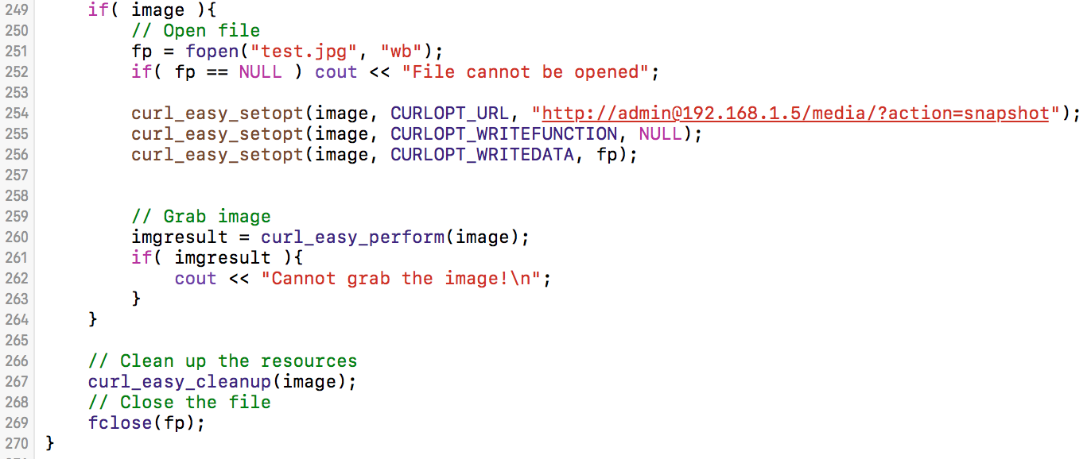
Image Retrieval
Open image file
Download image data
Replace image file data
Jeremiah McCutcheon

Slide 24
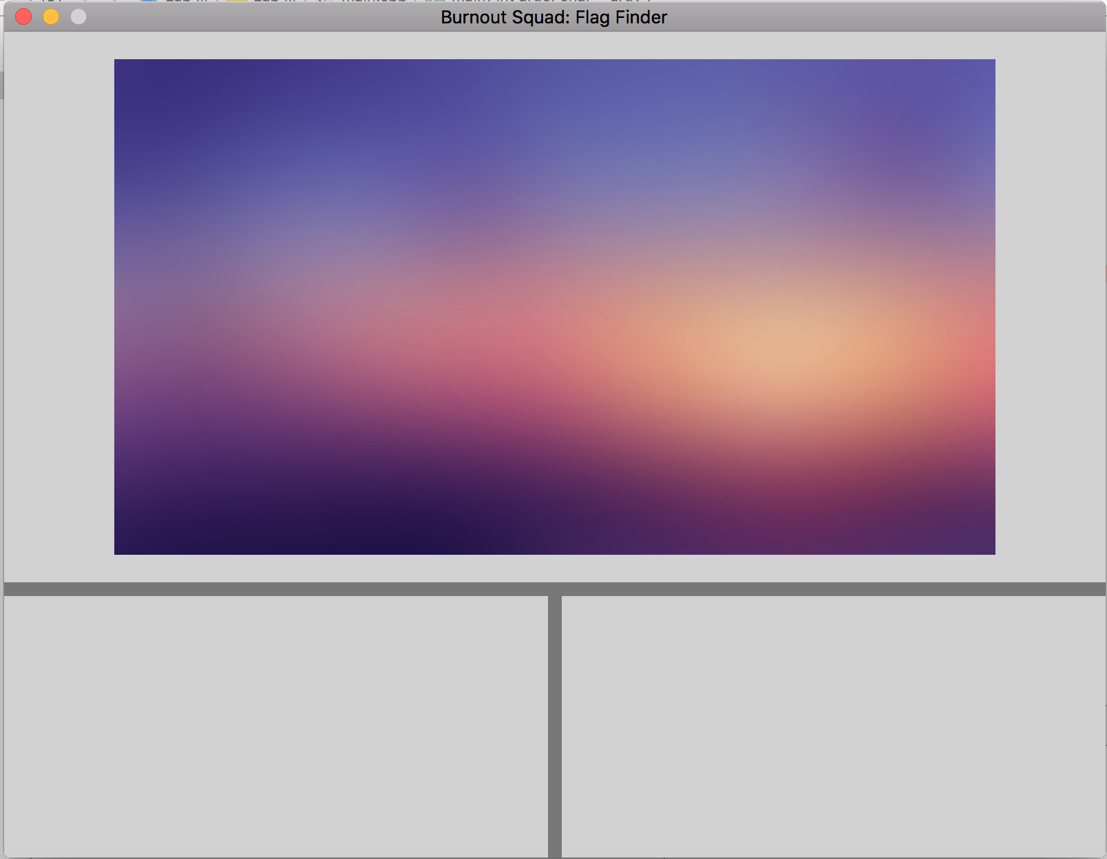

SDL GUI
Console Area
Jeremiah McCutcheon

Slide 25
Show “LiveCamera” Video
Jeremiah McCutcheon

Slide 26
Robot modes:
Seek mode:
Robot attempts to follow the closest possible RSSI strength to the nearest flag
Blob mode:
Robot has discovered a blob on the camera and will now navigate to pick up the flag
Pickup mode:
Movement controls will deactivate while the robot retrieves the flag
Avoid mode:
Robot has detected a barrier to movement and will utilize ultrasonic sensors to navigate a tight space.
Jeremiah McCutcheon

Slide 27
What’s Next
OpenCV Blob detection algorithm
RSSI integration
Custom navigation algorithm
GUI text read-out
Jeremiah McCutcheon

Slide 28
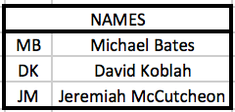
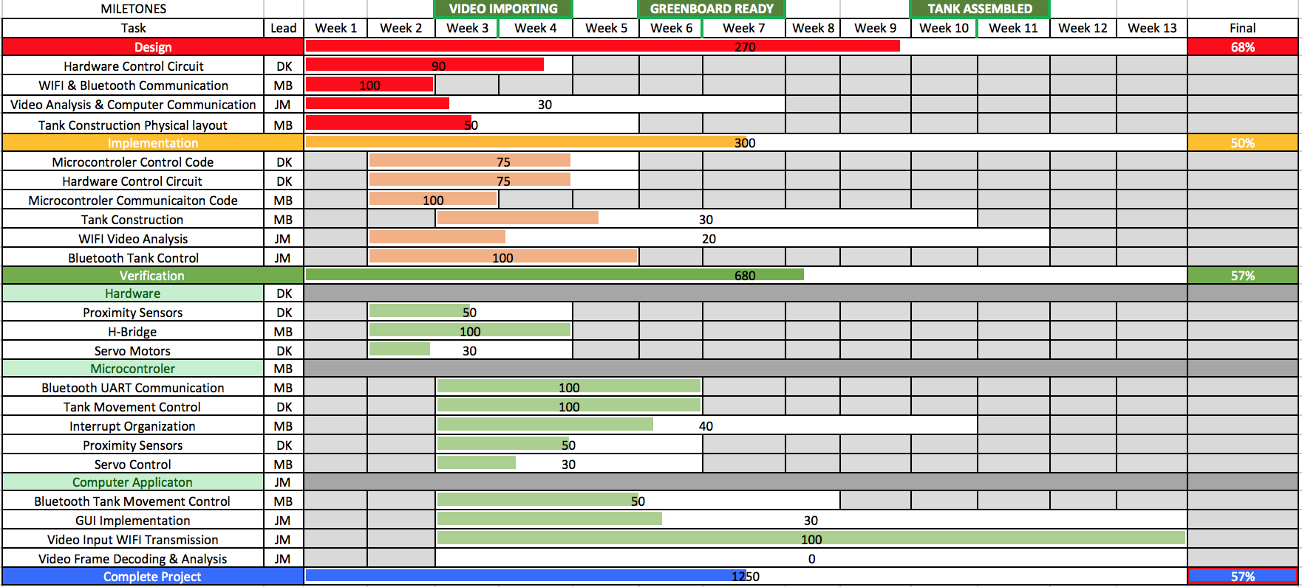
Gantt Chart
Jeremiah McCutcheon

Slide 29
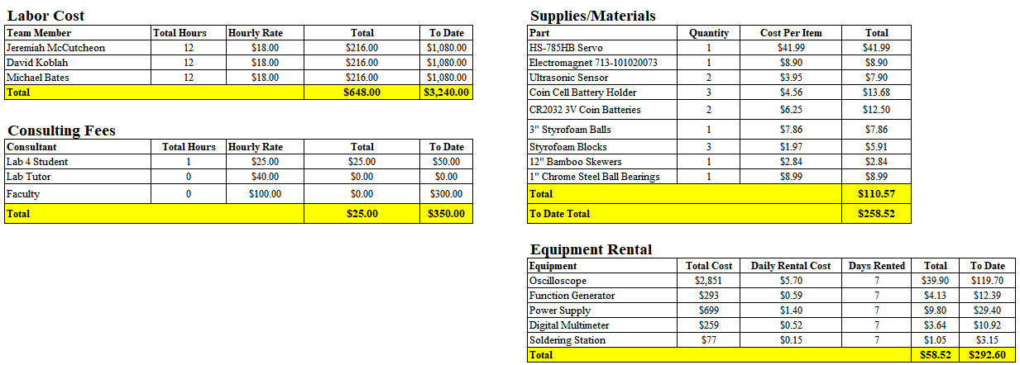
Budget
Michael Bates

Slide 30
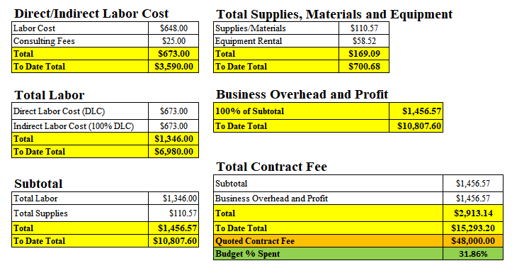
Budget Continued
Michael Bates

Slide 31
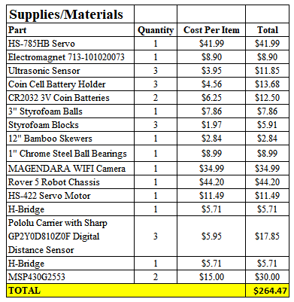
To Date Parts List
Michael Bates

Slide 32
Next Week’s Deliverables
Jeremiah
Implement Blob Identification
Begin work on navigation algorithm
Integrate RSSI
David
Finalize Complete Design of Autonomous Flag Finder
Integrate Robot Arm and Camera Radar Sequence
Assist With Miscellaneous Tasks
Michael
Finalize PCB
Get It Double Checked
Create Parts List
Place Orders
Test and Finalize Sensor Navigation Code
David Koblah

Slide 33
References
Michael Bates

Slide 34
Questions?

